Slide 1
Quantum Computing
Industry Perspective
Roberto Cappuccio
Istituto Nazionale di Fisica Nucleare - Pisa

Slide 2
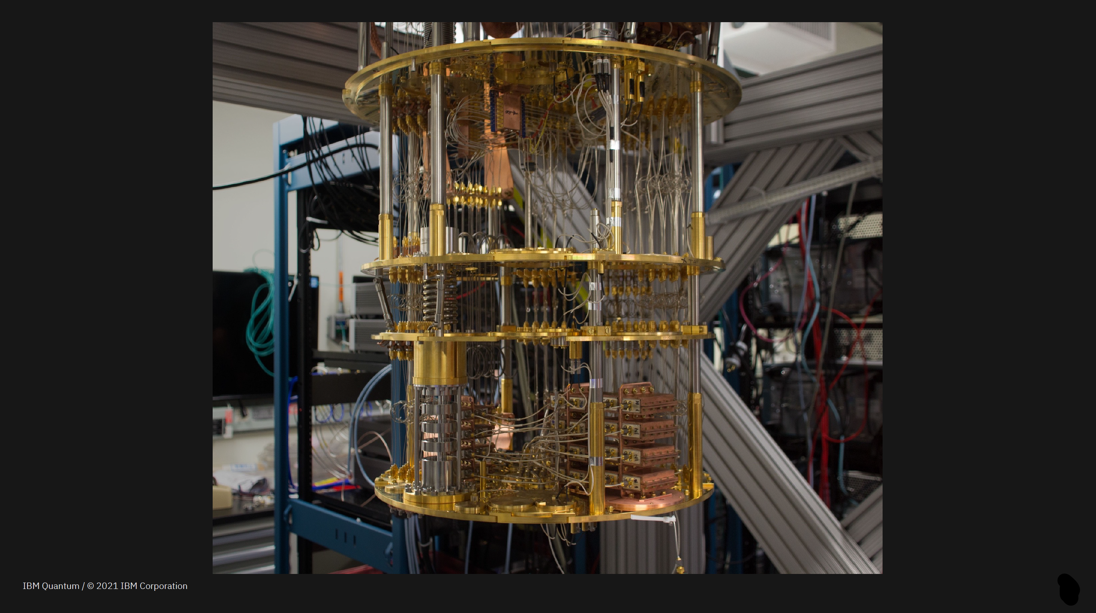
Quantum Computer: what’s that?

Slide 3
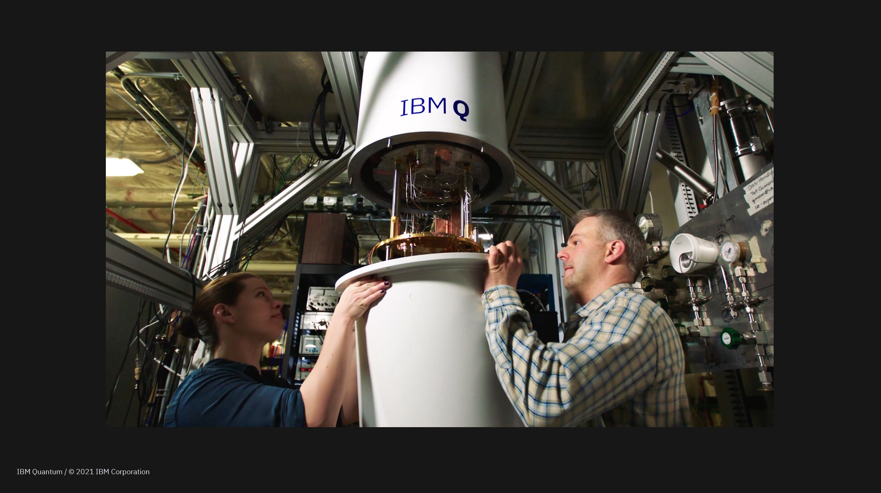
Quantum Computer: what’s that?

Slide 4
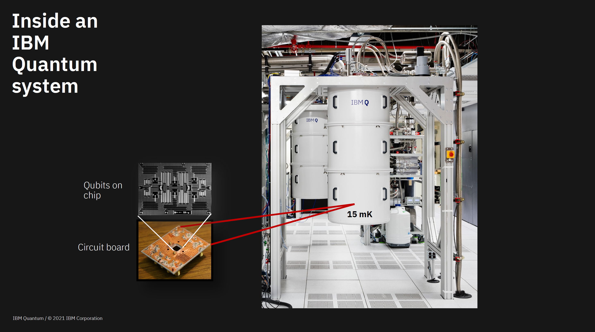
Quantum Computer: what’s that?

Slide 5
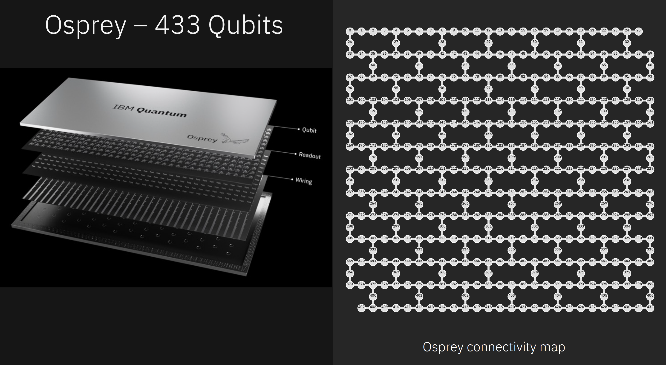
Quantum Computer: what’s that?

Slide 6
IBM Resource Dashboard
Demo Dashboard

Slide 7
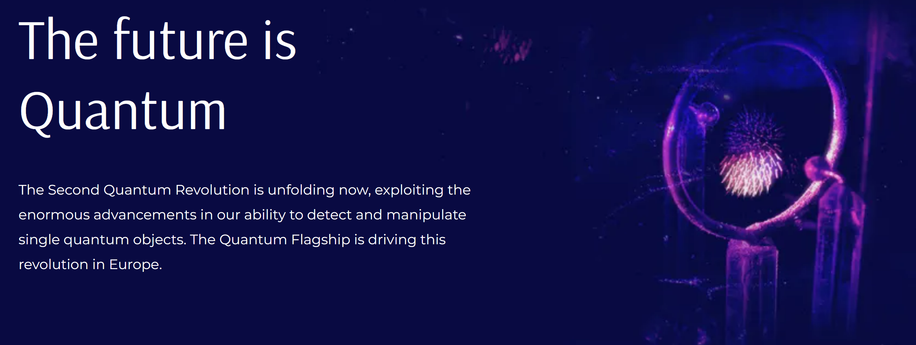
European Quantum Flagship

Slide 8
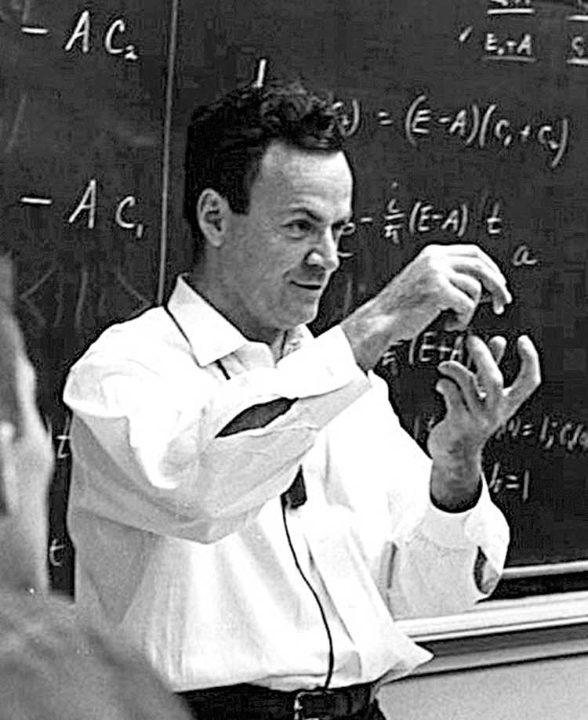
Why Quantum?
“I'm not happy with all the analyses that go with just the classical theory, because nature isn't
classical, dammit, and if you want
to make a simulation of nature,
you'd better make it quantum
mechanical ...”
Richard P. Feynman
Department of Physics,
California Institute of Technology
International Journal of Theoretical Physics,
Vol 21, Nos. 6/7, 1982

Slide 9
Why Quantum?
Problems we cannot adequately address today
Problems we hope to
address with quantum
and classical
computing
Problems we can address today classically

Slide 10
Why Quantum Now?
Ask an MIT Professor: Why Your Business Should Build a Quantum-Ready Workforce Now
Open Learning
The Curve
1. MITIGATE RISK AND PREVENT SURPRISES
2. DEVELOP QUANTUM-INSPIRED ALGORITHMS TO CREATE PERFORMANCE ADVANTAGES
3. ENSURE LONG-TERM PROTECTION OF ENCRYPTED INFORMATION
4. FILTER OUT THE HYPE

Slide 11
Why Quantum Now?
MIT has started a quantum computing program for professionals
    MIT xPRO - Quantum Program
Accenture is exploring quantum computing in Financial Services
    Accenture Quantum Initiative
Intesa started a «quantum» startup
Intesa San Paolo Quantum Initiative

Slide 12
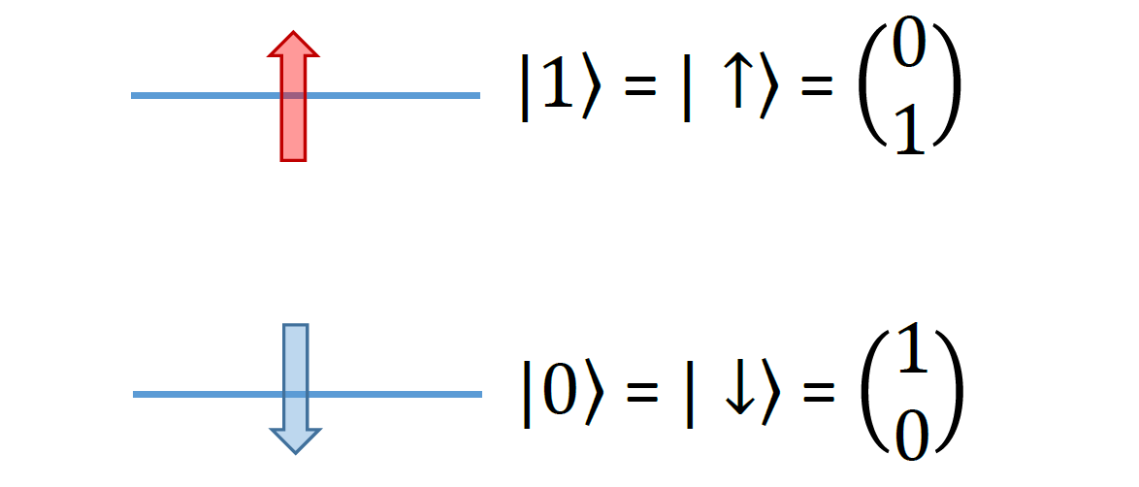
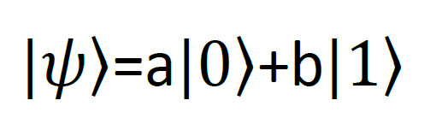
What does Quantum Computing rely on?
The basis of Quantum Computation is the Qubit:
a 2-level Quantum Mechanics system

Slide 13
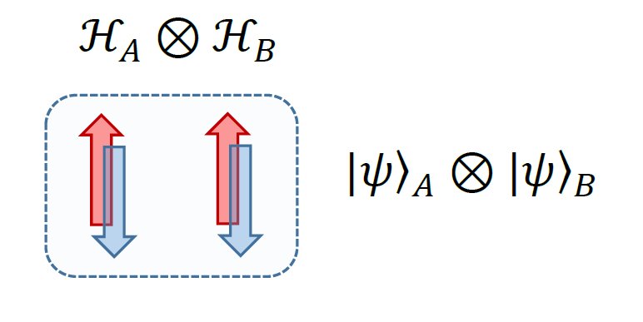
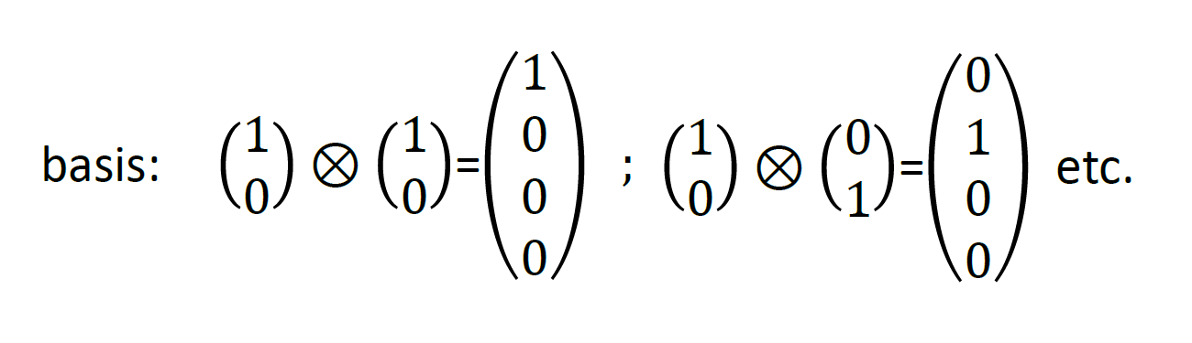
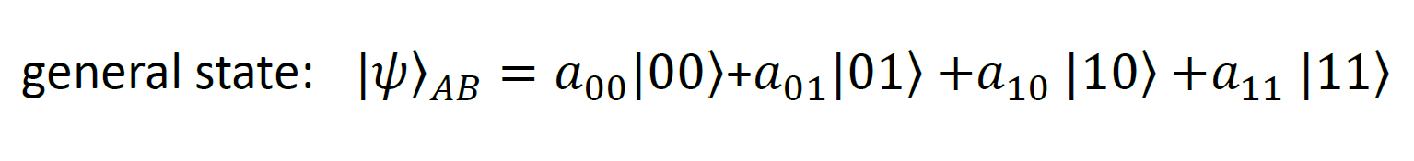
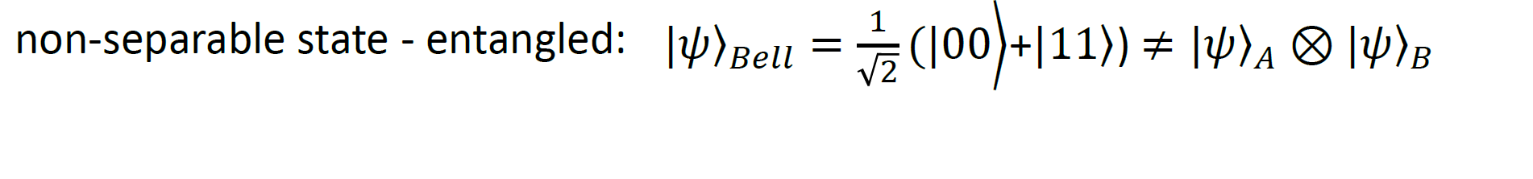
What does Quantum Computing rely on?
Qubits can be stacked together:

Slide 14

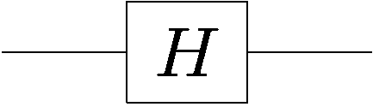

Gates and Circuits
Circuit diagrams for quantum information
quantum gate
input
wave
function
output
wave
function
quantum wire
single line = qubit
time
Quantum circuits are instructions for a series of unitary evolutions (quantum gates) to be executed on quantum Information.

Slide 15
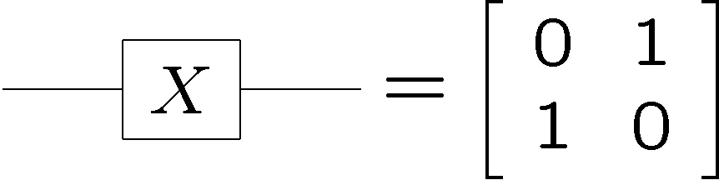
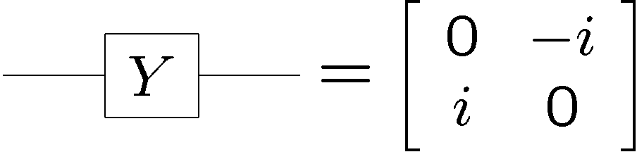


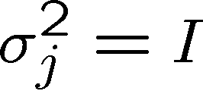
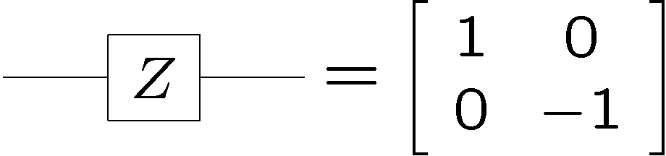


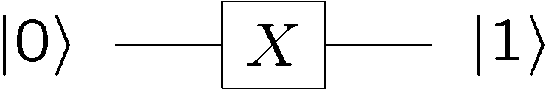
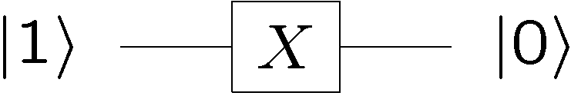
Important Qubit Gates
“bit flip”
not a straightforward meaning
Pauli’s matrices
“phase flip”
“bit flip” is just the classical not gate
Gate composition
Notes:
Gate a singolo qubit
Le matrici di Pauli

Slide 16
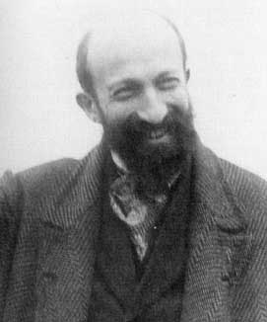
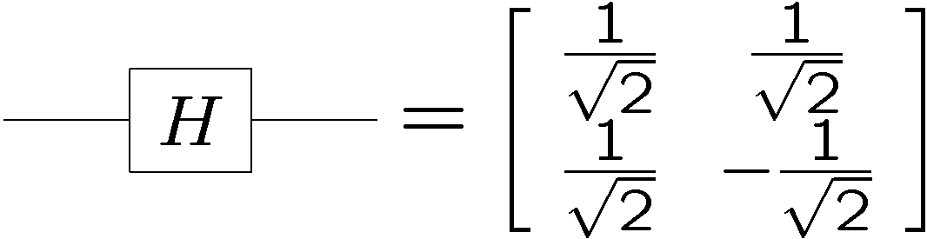

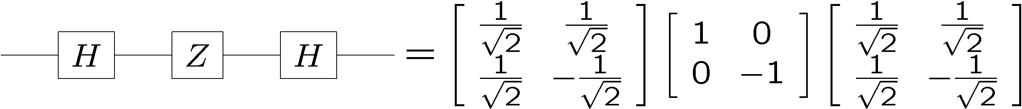
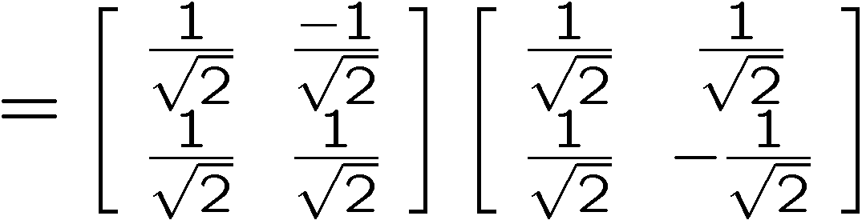
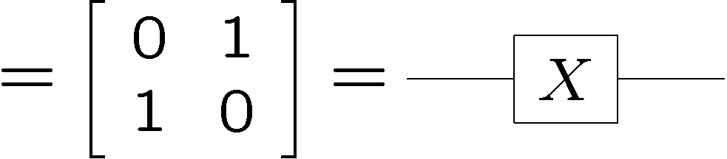
Important Qubit Unitaries
Hadamard gate:
Jacques Hadamard 1865-1963
Notes:
Il gate di Hadamard, fondamentale per la creazione degli stati entangled

Slide 17
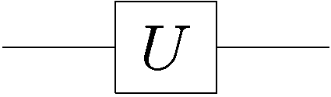
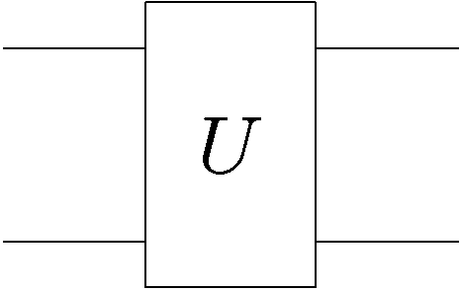

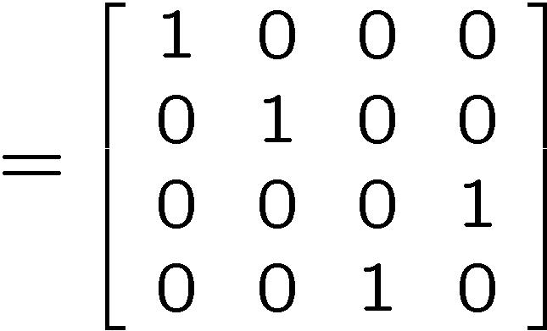
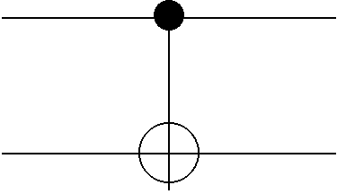



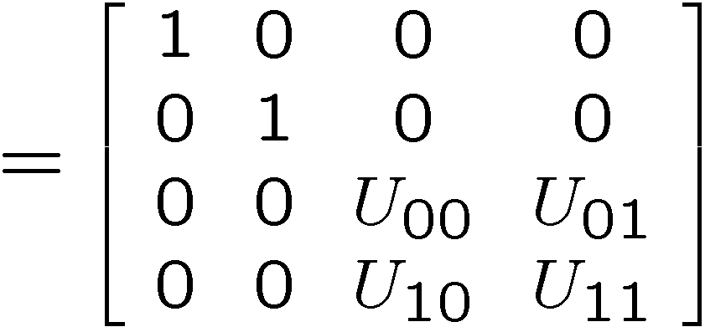
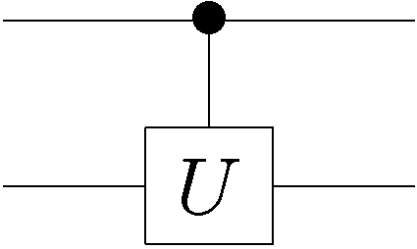
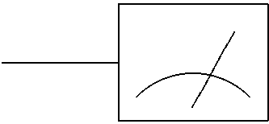

Quantum Circuit Elements
single qubit rotations
two qubit rotations
control
controlled-NOT
target
control
controlled-U
target
measurement in the basis
Notes:
Gate che coinvolgono due o potenzialmente più qubit

Slide 18
Quantum Composer
Demo Composer

Slide 19
Qiskit Introduction
Demo Qiskit
Notes:
Provare a costruire uno stato entangled

Slide 20
Main Algorithms as «Lego Bricks»
Teleportation
Superdense Coding
Quantum Cryptography
Deutsch
Deutsch-Jozsa
«Oracle» Problems
(guess the function)
Grover
Search Speed-up
Quantum Phase Estimation (QPE)
Linear Algebra / Shor

Slide 21

Quantum Teleportation
Alice wants to send her qubit to Bob
She does not know the wave function of her qubit
Alice
classical communication
Bob
Alice and Bob share an entangled pair of qubits
Alice makes a measure on her state and send him classical bits of information about the outcome
Then Bob would have information about as well
This would be a procedure for extracting information from without effecting the state
Notes:
Analisi del protocollo di teletrasporto quantistico

Slide 22
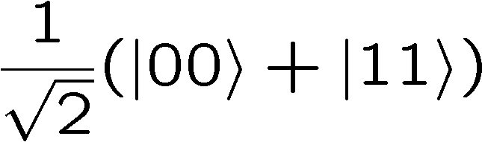
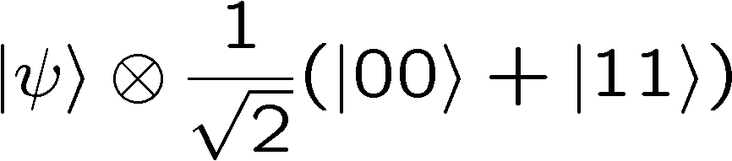
Quantum Teleportation
Alice shares with Bob an entangled state
Alice does not know the wave function
ALICE
BOB
So we have three qubits whose wave function is:
qubit 1
qubit 2 and qubit 3

Slide 23
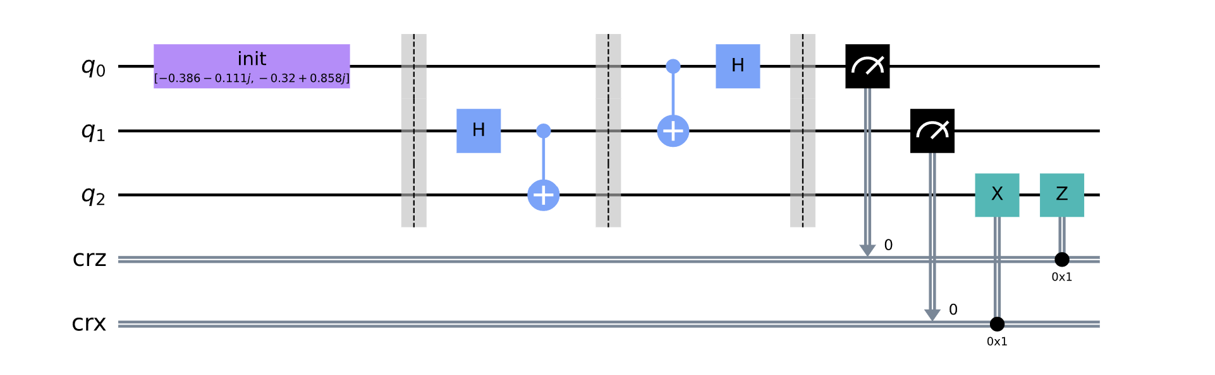
Quantum Teleportation
Quantum Circuit used to simulate Teleportation:
Alice makes a measure on q₀ and q₁ and send the bits to Bob
00 → does nothing
01 → applies X gate
10 → applies Z gate
11 → applies ZX gate
Bob reads them and if
then q₂ q₀

Slide 24
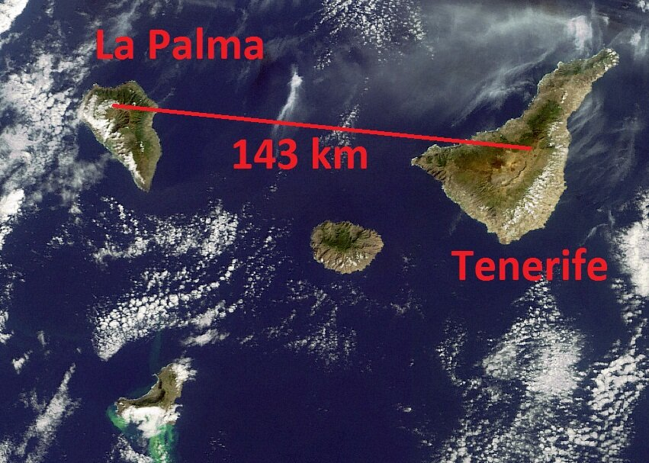
Quantum Teleportation
ESA observatory breaks world quantum teleportation record
An international research team using ESA’s Optical Ground Station in the Canary Islands has set a new distance world record in ‘quantum teleportation’ by reproducing the characteristics of a light particle across 143 km of open air.

Slide 25
Quantum Teleportation
Demo Teleportation

Slide 26
More algorithms?
Go to algorithms

Slide 27
Quantum Computing in the Real World
Whats next?

Slide 28
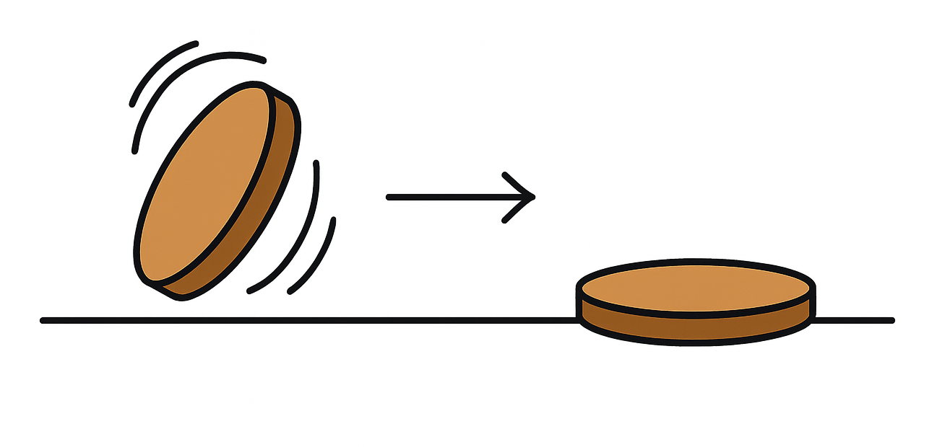
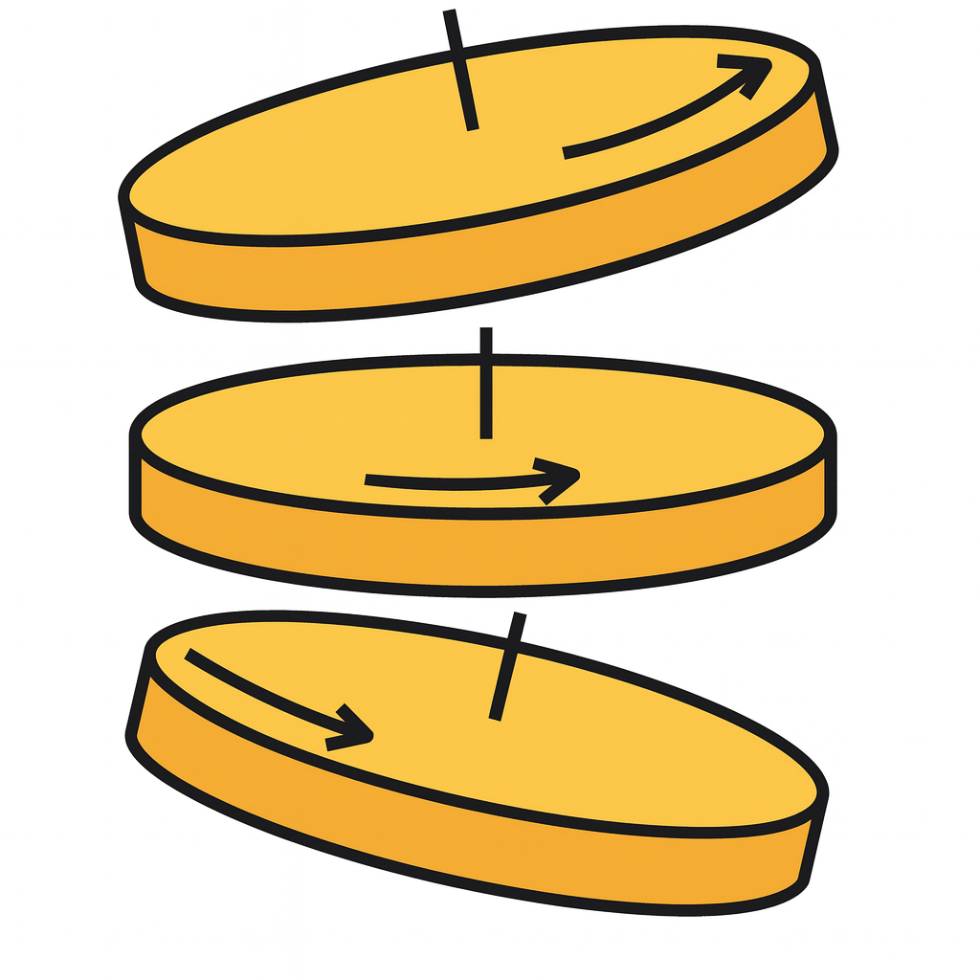
Anche i Qubit sbagliano: errori T1 e T2
T1
T2
Tempo di Rilassamento
Tempo di Coerenza
Che cos'è: Il qubit perde energia e 'cade' dallo stato eccitato |1⟩ allo stato base |0⟩.
Analogia: Una moneta che gira, rallenta e infine cade piatta sul tavolo.
Impatto: Perdita irreversibile dei dati.
Che cos'è: Il qubit mantiene l'energia ma perde la sincronia (fase) con gli altri.
Analogia: Una moneta che continua a girare, ma inizia a oscillare (wobble), rendendo impossibile leggere il valore.
Impatto: Errori di calcolo immediati.

Slide 29
La Sfida della Scalabilità: Fisico vs Logico
Qubit FISICO (Hardware)
Qubit LOGICO (Error Corrected)
• È l'oggetto materiale (ione, circuito, atomo)
• Estremamente fragile e rumoroso (soggetto a errori T1 e T2)
• Da solo, non è sufficiente per calcoli lunghi e complessi.
• Un insieme di molti qubit fisici che lavorano all'unisono
• L'algoritmo (QEC) corregge gli errori in tempo reale
• È l'unità 'virtuale' stabile su cui gireranno i software
finanziari.
UPDATE MERCATO 2024: Il rapporto di efficienza
Stima Storica Standard: Servivano ~1.000 qubit fisici per 1 qubit logico.
Risultato recente (Microsoft & Quantinuum, Apr 2024): ottenuti 4 qubit logici affidabili usando solo 30 qubit fisici.
Nuovo Rapporto Benchmark: ~7.5 : 1 (Drastica riduzione dei costi hardware necessari).

Slide 30
Perché serve l'Hardware? Il limite dei Simulatori
La Maledizione della Dimensionalità
Case Study: Supercomputer JUPITER
Per simulare un sistema quantistico su un computer classico, dobbiamo memorizzare l'intera funzione d'onda.
La memoria richiesta RADDOPPIA per ogni singolo Qubit aggiunto:
• 1 Qubit = 2 numeri complessi
• 10 Qubit = 1.024 numeri
• 50 Qubit = 1.125.899.906.842.624 numeri!
Recente esperimento sul supercomputer Exascale europeo (Jülich Supercomputing Centre).
Obiettivo: Simulare un circuito quantistico randomico.
RISULTATO:
Per simulare appena 45-50 Qubit, il sistema ha dovuto allocare PETABYTE di memoria RAM distribuita.
Conclusione: Oltre i 50-60 qubit, nessun computer classico dell'universo può bastare. Ecco perché dobbiamo costruire qubit reali.

Slide 31
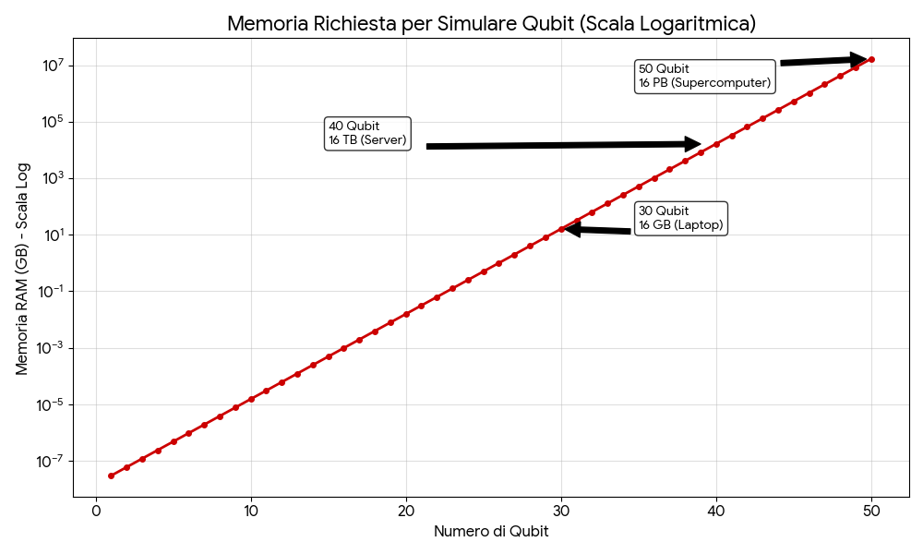
Perché serve l'Hardware? Il limite dei Simulatori

Slide 32
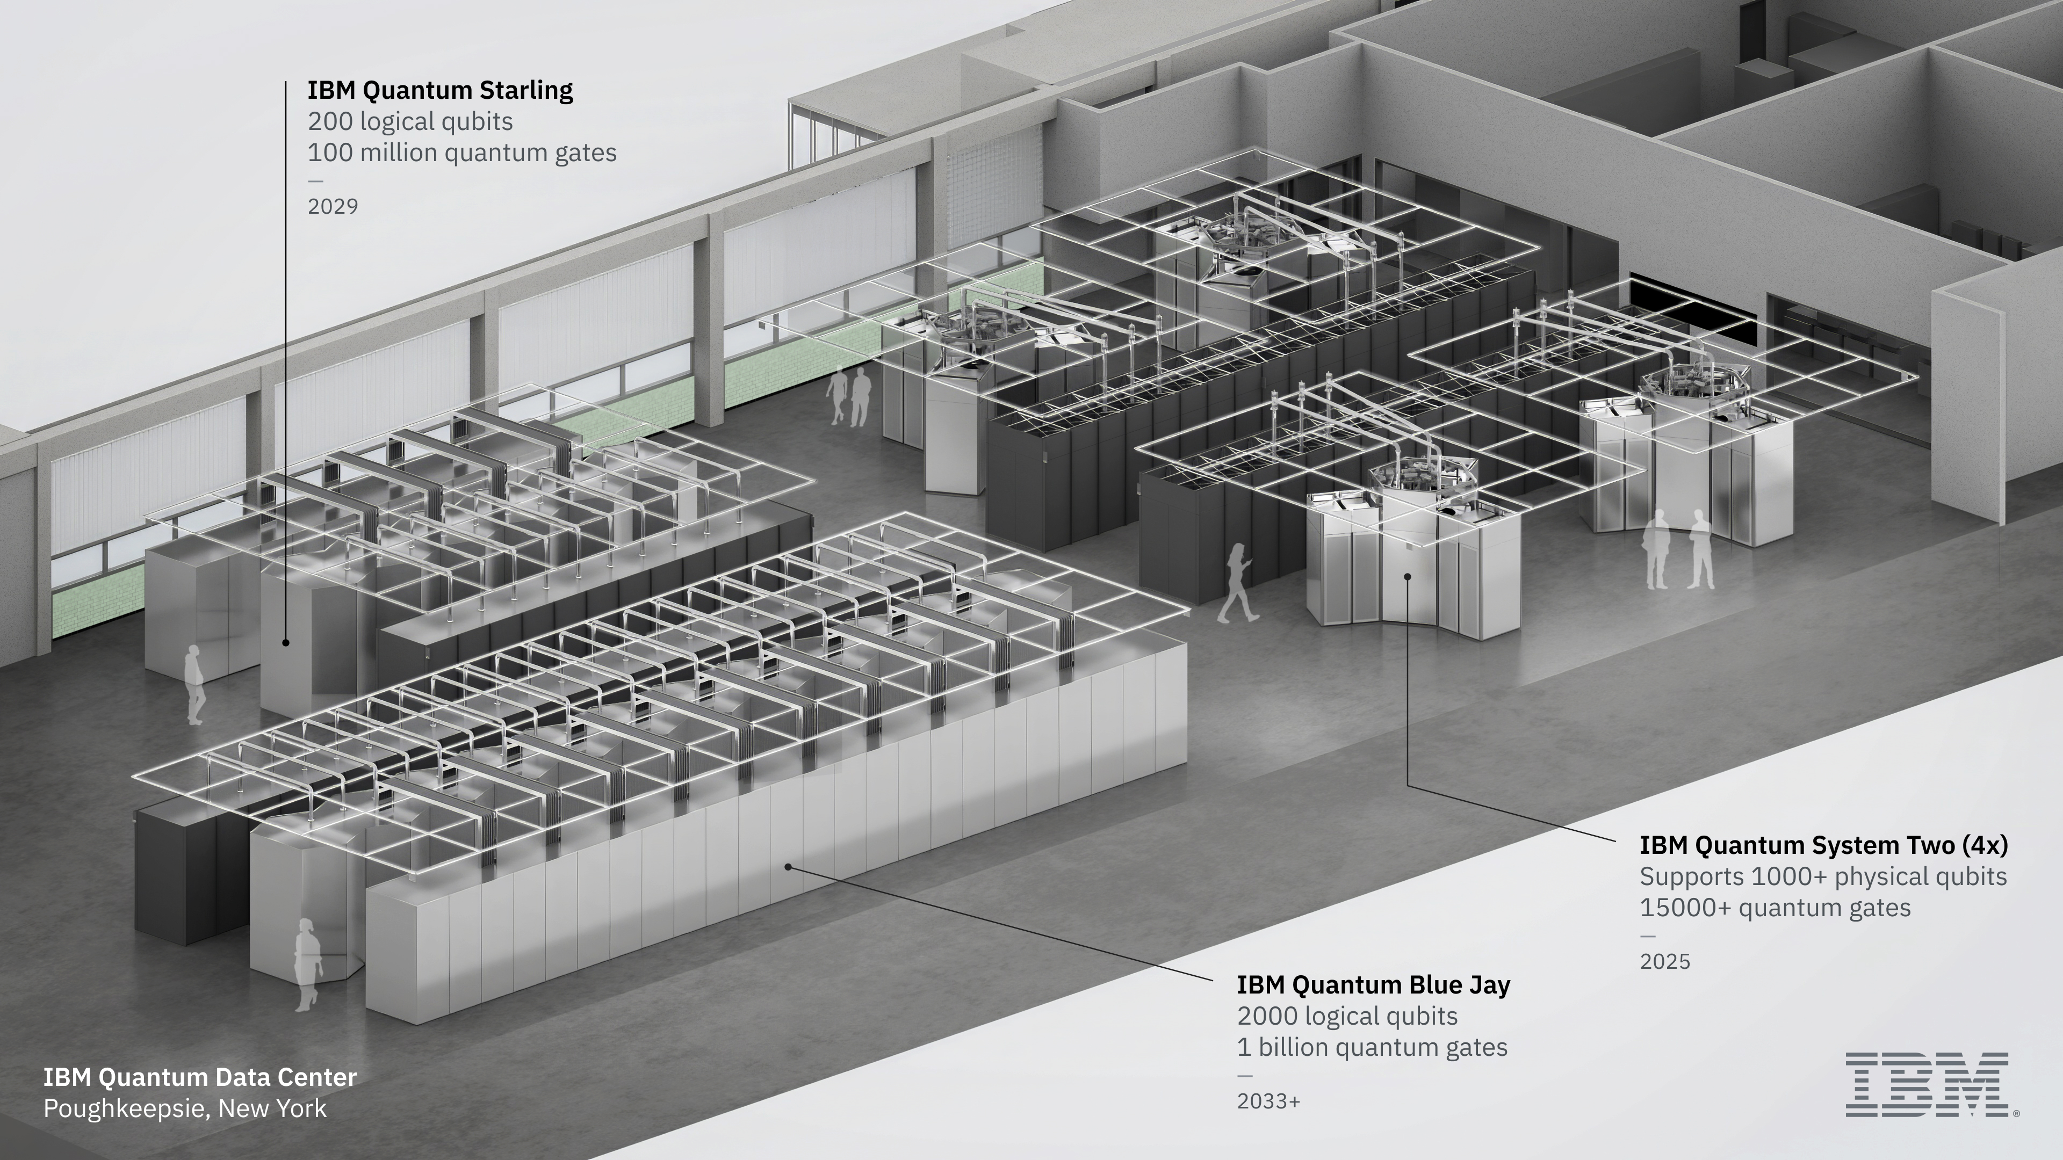
QC Superconduttivo: come sarà

Slide 33
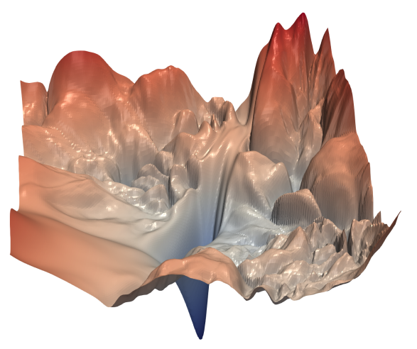
La Frontiera: Quantum Machine Learning (QML)
Algoritmi Standard (QPE, Shor, Grover…)
Quantum Machine Learning (Variational)
• Richiedono precisione assoluta
• Il rumore distrugge il calcolo
• Necessitano Qubit logici
• Tollerano il rumore (Noise Resilience)
• Ottimizzazione iterativa
• Funzionano su NISQ (Qubit Fisici)
Il vantaggio del rumore nell'ottimizzazione
[INCOLLA QUI L'IMMAGINE 'LOSS LANDSCAPE']
I problemi complessi hanno molti ‘minimi locali’.
Il rumore quantistico agisce come una scossa sismica che permette all'algoritmo di "saltare fuori" dalle buche locali e trovare il 'minimo globale' (soluzione ottimale)
Fig. 1: Visualizzazione di un 'Loss Landscape' non convesso (Fonte: Li et al., NeurIPS 2018)

Slide 34
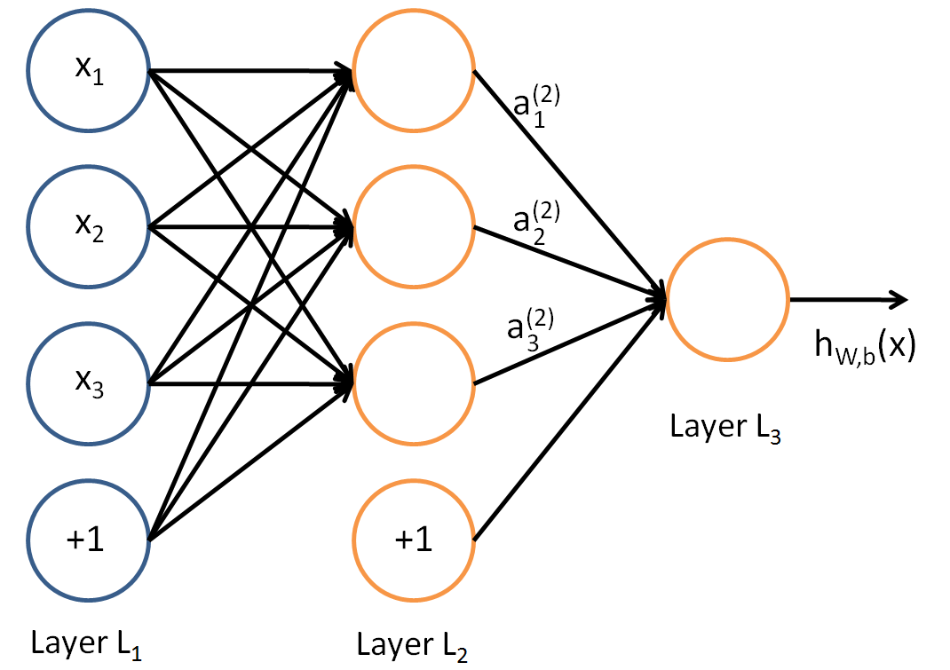
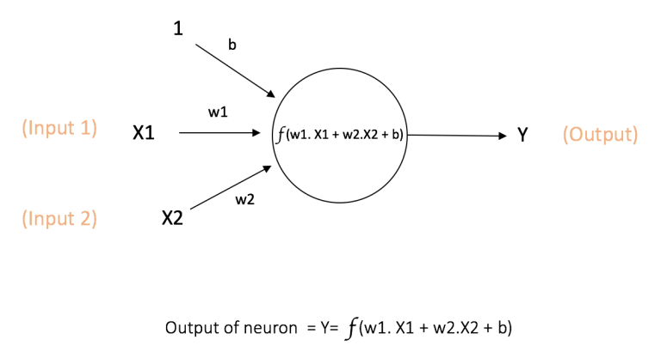
Un passo indietro: le Reti Neurali classiche
Le reti neurali si ispirano all'"architettura" del cervello umano e l'elemento base è appunto il «neurone artificiale».
I neuroni sono interconnessi e raggruppati in strati.
Allo strato dei neuroni segue una funzioni di attivazione per generare la risposta finale (a gradino, a sigmoide, ReLU,...).
.

Slide 35
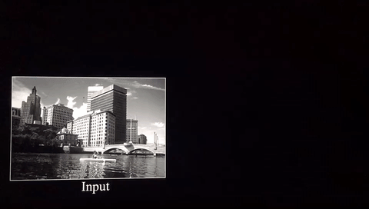
The Frontier: CNN vs Quantum Machine Learning
Convolutional neural networks (ConvNets or CNNs) are a category of neural networks¹ that have proven to be very effective in tasks such as image recognition and classification
Convolution works by extracting a feature map from a source image:
¹https://ujjwalkarn.me/2016/08/11/intuitive-explanation-convnets/

Slide 36
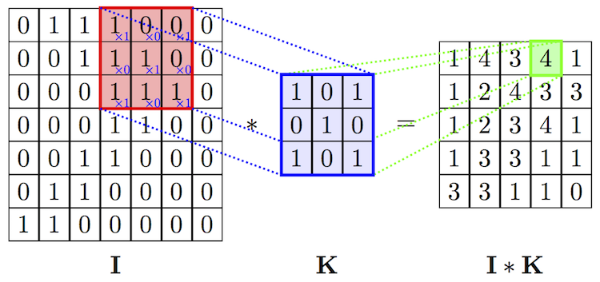
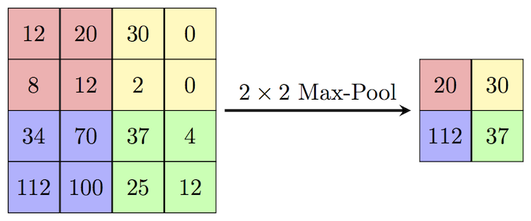
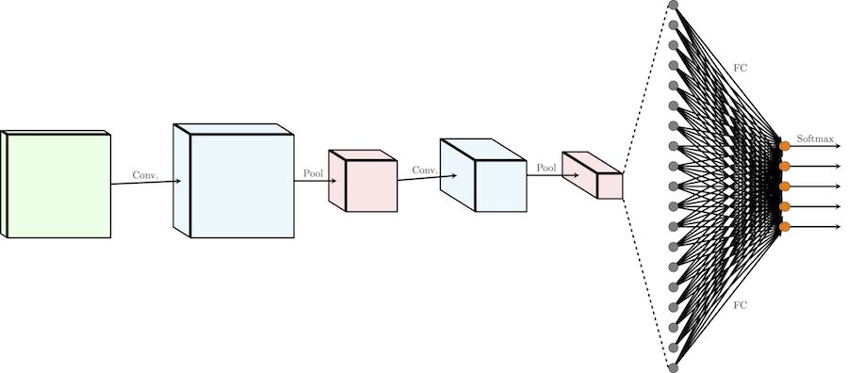
CNN Schema
Filtering
Pooling
Flattening
Convolutional Blocks:
  Filtering
  Pooling
Alternating Convolutional Blocks
Flattening
Multi Perceptron Layers (MPLs)
Alternating Blocks
MPLs

Slide 37
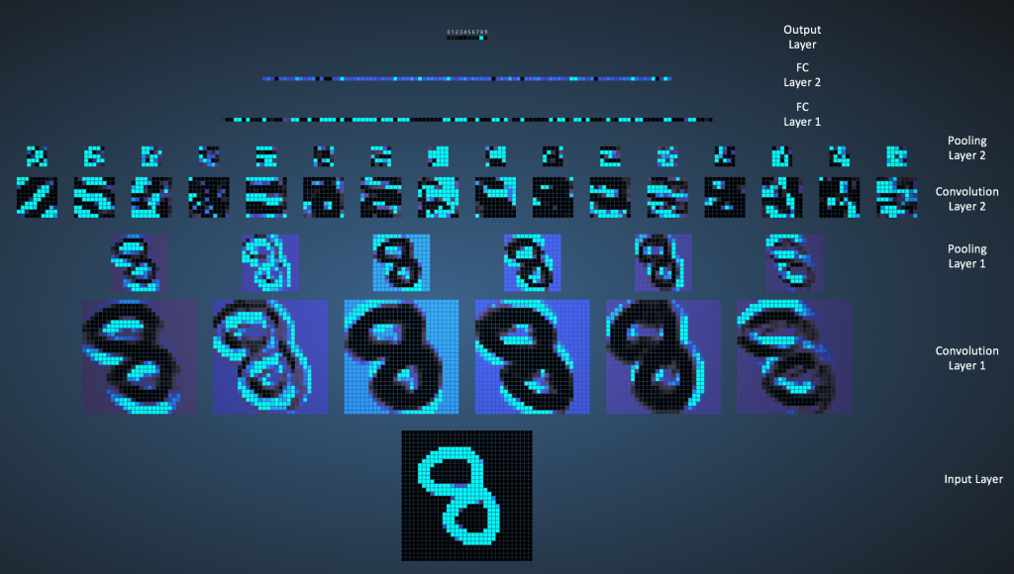
CNN ON MNIST
How a convolutional network classifies handwritten numbers:

Slide 38
CNN AT WORK
Demo CNN

Slide 39
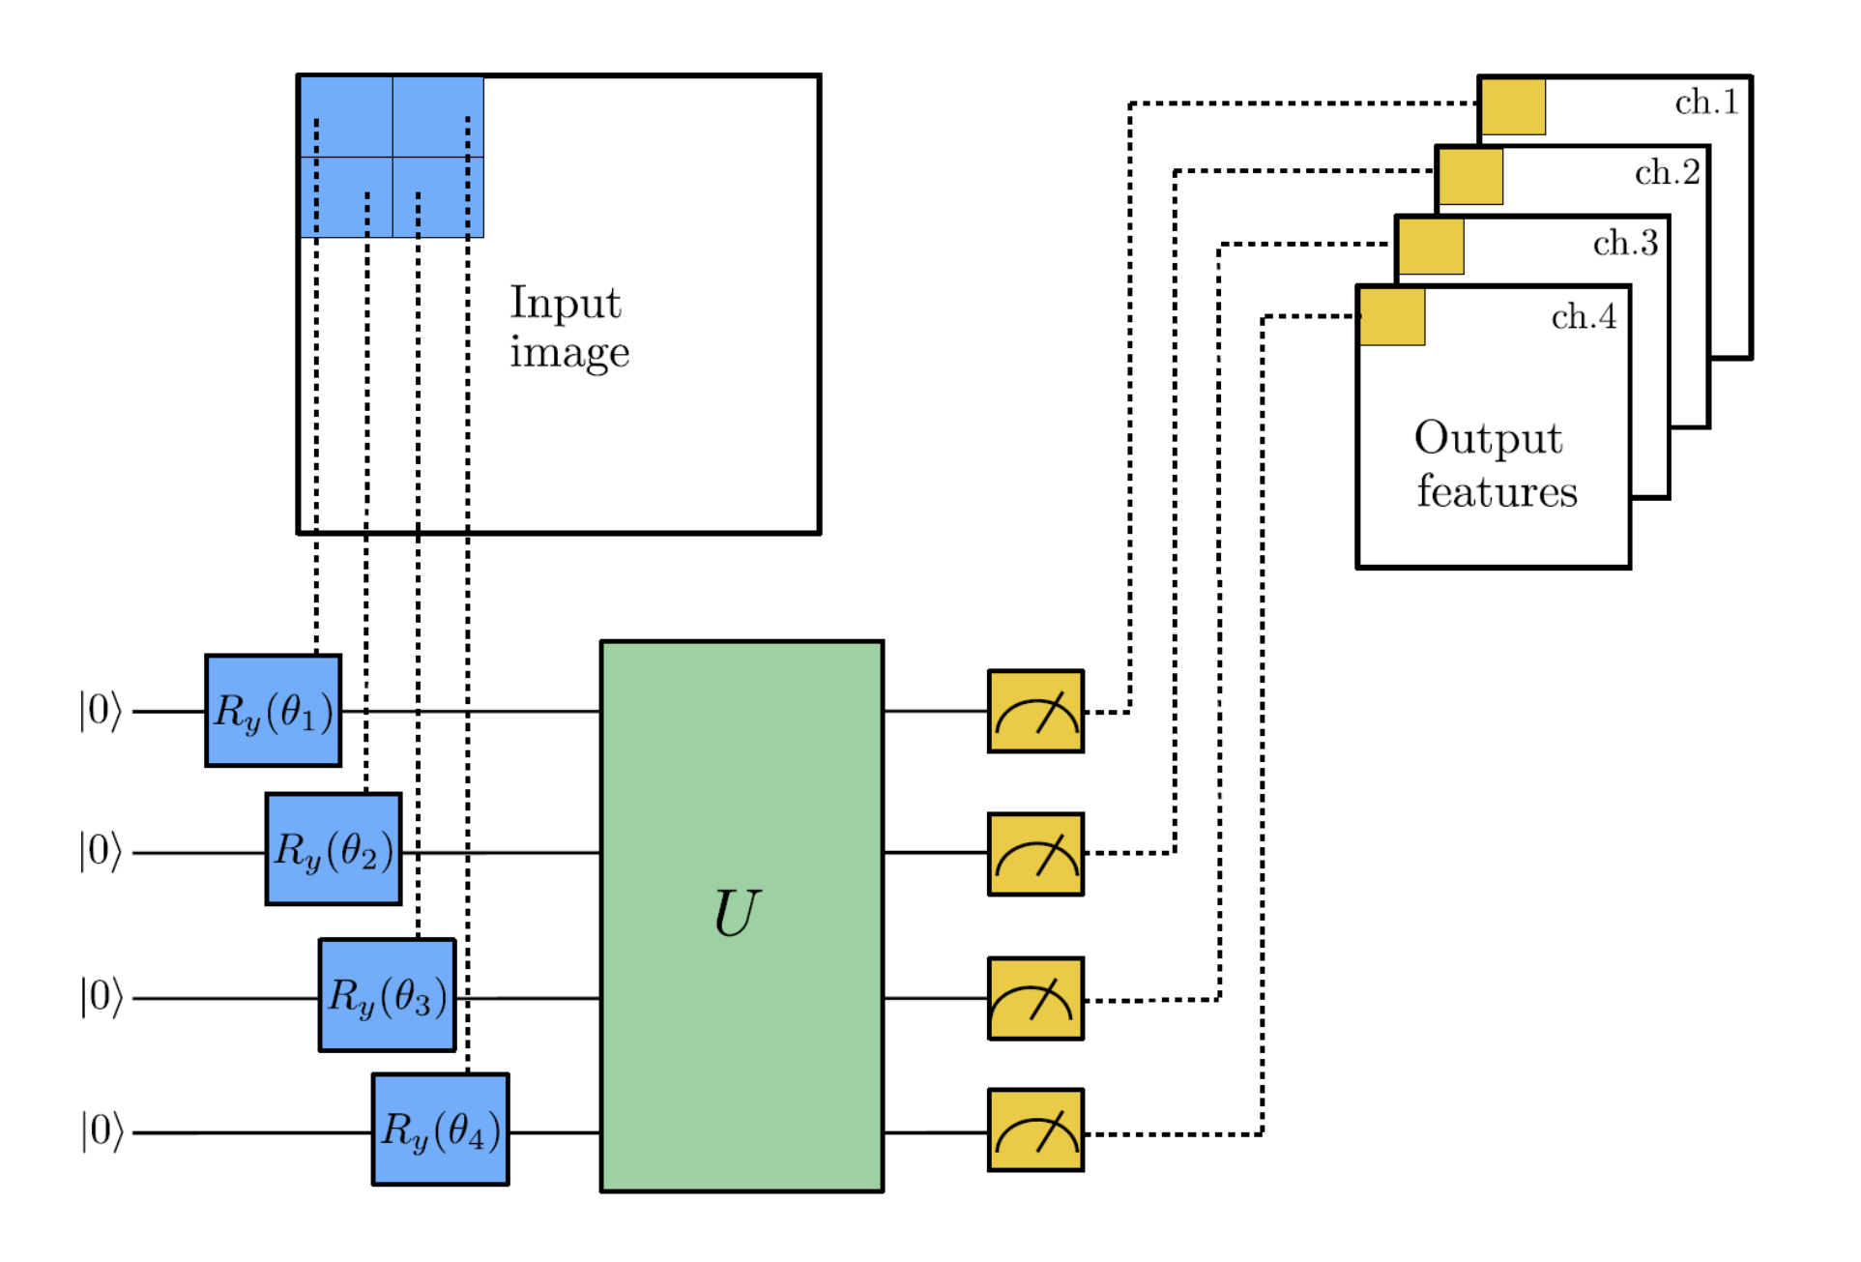

The Frontier: Quantum Machine Learning
Pennylane Quanvolution
Quanvolutional Neural Networks
Author: Andrea Mari — Posted: 24 March 2020. Last updated: 15 January 2021
Originally introduced by Henderson et alii in 2019

Slide 40
Pennylane Quanvolution
Demo Quanvolution

Slide 41
Questions & Answers
Q&A

Slide 42
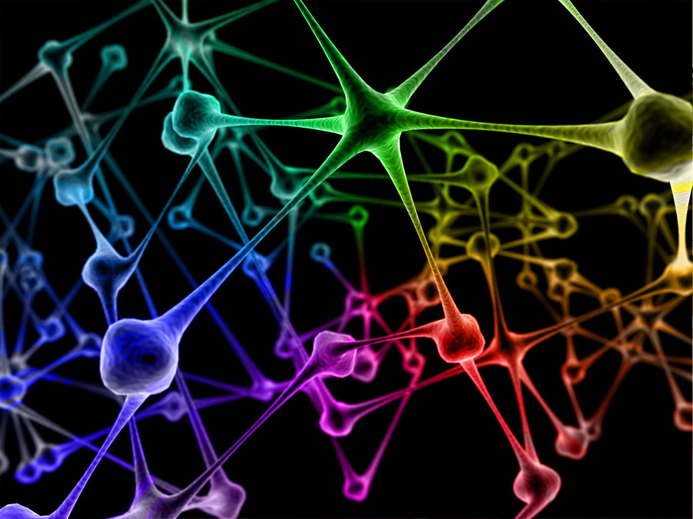
Thanks for your attention!

Slide 43
Appendix
More Algorithms

Slide 44

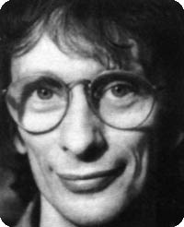




«Oracle» Problems: Deutsch Algorithm
Given one bit function:
Four such function, it may be:
“constant”
“balanced”
David Deutsch 1985
Deutsch’s Problem
instance: function f is unknown
problem: determine whether function is constant or balanced

Slide 45










Quantum Deutsch
U_{f}
f constant f=0
f constant f=1
f balanced f={0,1}
f balanced f={1,0}

Slide 46
Deutsch Algorithm
Demo Deutsch

Slide 47









Searching speed-up: Grover Algorithm
Suppose we have a black box:
n qubit
1qubit
with the property:
Problem: find with as few queries as possible
Solution: identify the item in “only” queries!

Slide 48





Grover Iterate Block
n qubits
Lov Grover 1996
Grover’s iterate

Slide 49
Grover Algorithm
Demo Grover

Slide 50







Quantum Phase Estimation Algorithm
We wanto to estimate a the phase ω given the quantum state
Note that in binary we can express as:
If ω=0.x₁ then we can do the following:

Slide 51





Quantum Phase Estimation Algorithm
It can be shown that:
So if ω=0.x₁x₂ then we can do the following:

Slide 52





Quantum Phase Estimation Algorithm
If ω=0.x₁x₂x₃ then we can do the following:

Slide 53
Quantum Phase Estimation Algorithm
Demo QPE

Slide 54


Shor’s Algorithm
A lecture on Shor’s quantum factoring algorithm
Samuel J. Lomonaco Jr.
Step 1. Choose a random positive integer m. Use the polynomial time Euclidean algorithm to compute the greatest common divisor gcd (m, N ) of m and N. If the greatest common divisor gcd (m, N) = 1, then we have found a non-trivial factor of N , and we are done. If, on the other hand, gcd (m, N ) ≠ 1, then proceed to STEP 2.
Step 2. Use QUANTUM PHASE ESTIMATION to determine the unknown period P of the function
Step 3. If P is an odd integer then goto Step 1. If P is even then goto Step 4.
Step 4. Since P is even, we have: (m^{P/2} + 1) (m^{P/2} – 1) = m^{P} – 1 = 0 mod N
If m^{P/2} + 1 = 0 mod N then goto Step 1. else goto Step 5.
Peter Shor 1994
Step 5. Use the Euclidean algorithm to compute d = gcd(m^{P/2} – 1, N). Since m^{P/2} + 1 ≠ 0 mod N it can easily be shown that d is a non-trivial factor of N. Exit with the answer d.

Slide 55
Shor’s Algorithm
Demo Shor

Slide 56
Quantum Cryptography: Threat or Opportunity?
RSA Cryptography is based on modular arithmetic and theory of numbers
RSA robustness is based on impossibility of factoring big numbers
Shor’s quantum algorithm potentially breaks the barrier

Slide 57
RSA Algorithm
Demo RSA

Slide 58
Breaking RSA
How to factor 2048 bit RSA integers in 8 hours using
20 million noisy qubits
Craig Gidney¹ and Martin Ekera²
¹Google Inc., Santa Barbara, California 93117, USA
²KTH Royal Institute of Technology, SE-100 44 Stockholm, Sweden
Swedish NCSA, Swedish Armed Forces, SE-107 85 Stockholm, Sweden

Slide 59
Breaking RSA
Have Chinese scientists really cracked RSA encryption with a quantum computer?
The researchers say they could crack 2048-bit RSA using a quantum computer with a few hundred qubits.
Not everyone is convinced.
By Ryan Morrison
techmonitor.ai

Slide 60
Basic References
Quantum Computation and Quantum Information
Michael A.Nielsen – Isaac L.Chuang – Cambridge Press
An Introduction to Quantum Computing
Philippe Kaye – Raymond Laflamme – Michele Mosca – Oxford University Press

Slide 61

The Very End!

